Slide 1
Transporter Project
Dhruvi Joshi

Slide 2
overview
HMMs
Annotate
Reference
Data Exploration
Clean-up
Hidden Markov Models, weight to amino acids in proteins sequences to classify them
Using the HMMER program we can run our sample protein sequences file against the HMMs to obtain matches
pick the best matches for each protein to create a reference database with unique proteins
Running protein sequences from sample against refences, we know what transport proteins are in our sample and ask deeper questions
Polish code in a way that is reproducible
Goal: To explore the role and function of Transporter proteins in North Pacific Plankton

Slide 3





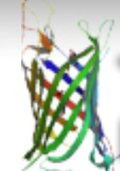
Tools
Git
Co-lab + Vscode
TcDoms + Interpro
Linux
Used for version control
Write python and bash scripts respectively
Currently sourcing HMMs from here
Running bash scripts for now, accesses remote server

Slide 4
Current Progress: scripts
Download tcDoms_HMM (bash)
Annotate script (bash)
Pick best annotation (python)
+4 scripts to generate plots (python)

Slide 5
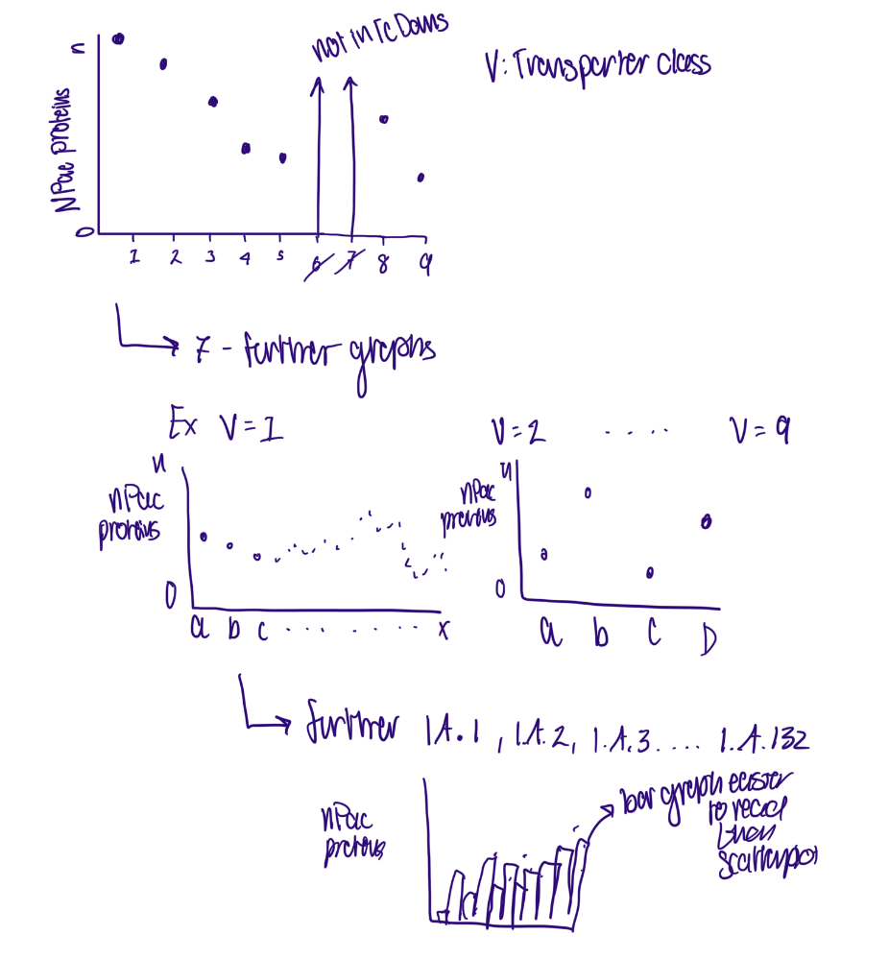
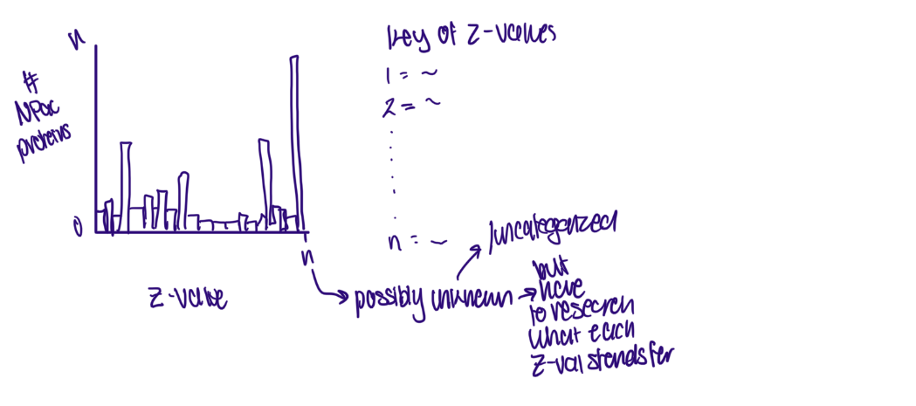
Data Exploration- Initial stages
Top: Which substrate has the most transporters specified for it?
Left: Which type of transporter proteins are the most abundant?

Slide 6
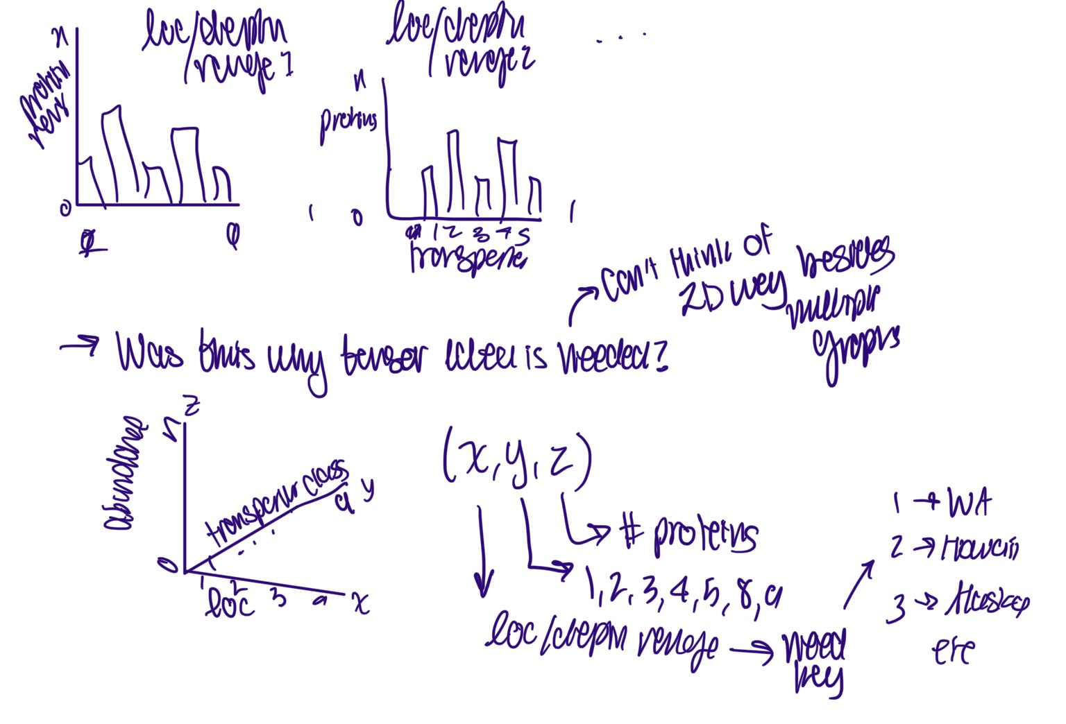
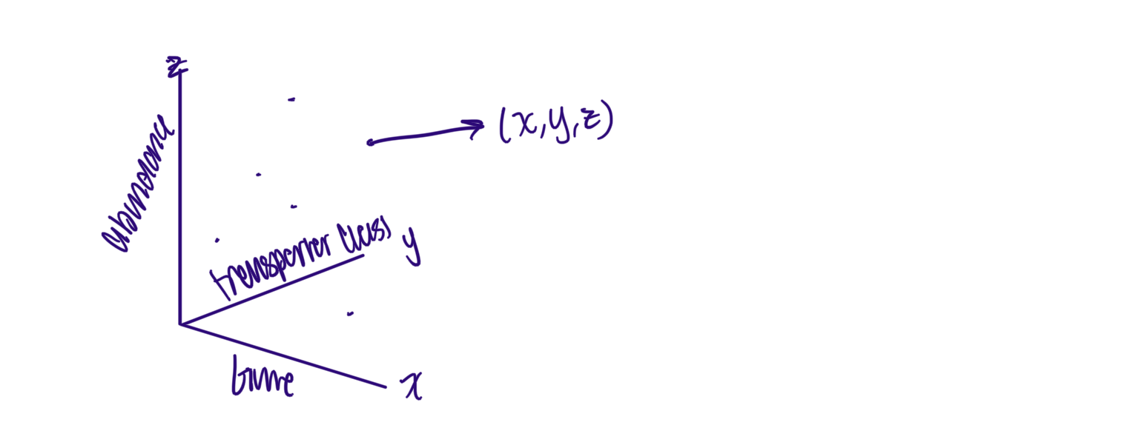
Data Exploration- initial stages
Top: How does time of day affect which transporters are activated?
Left: How does transporter abundance change with depth &/or location?

Slide 7
Data exploration
Progress

Slide 8
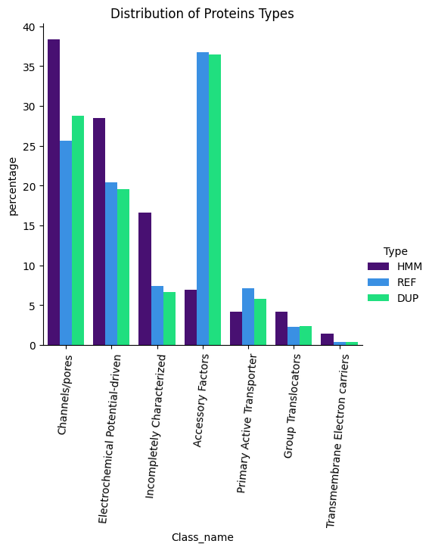

Slide 9
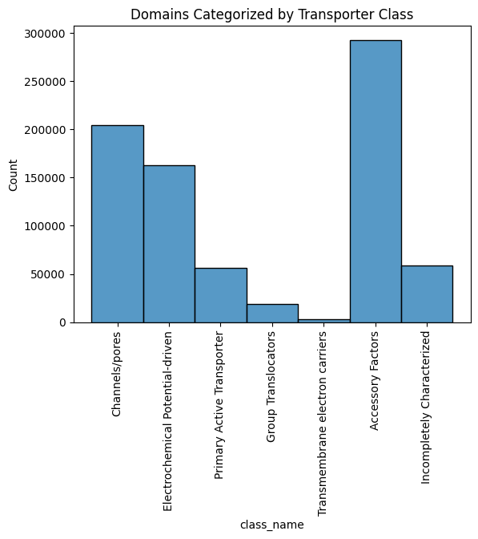
Breakdown of refences

Slide 10
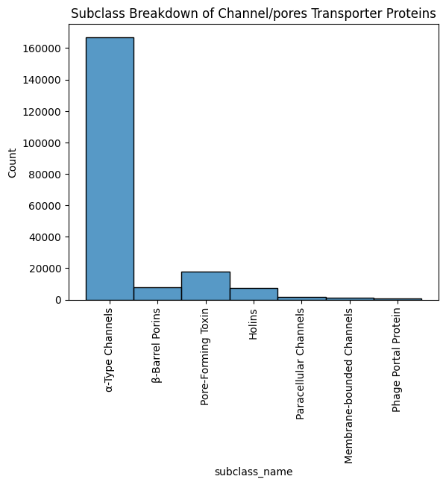
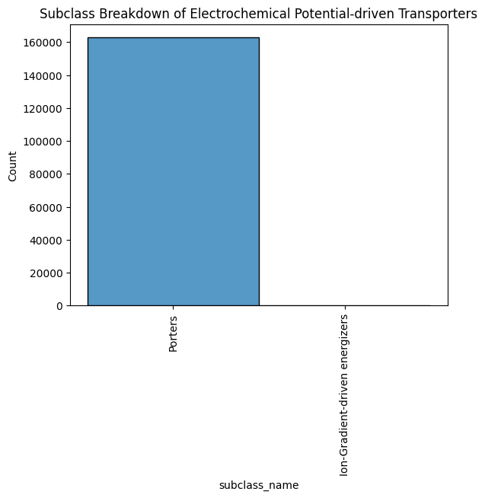
Refs broken down by subclass

Slide 11
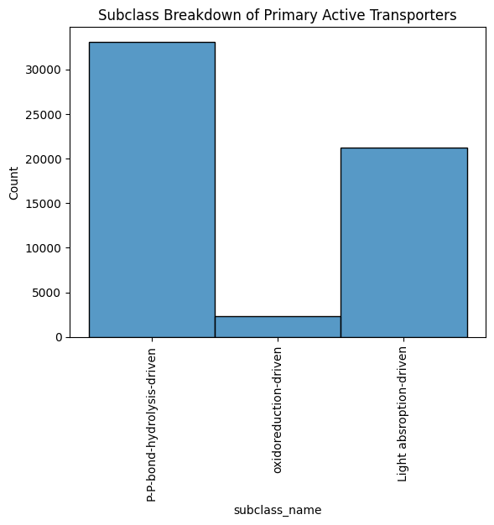
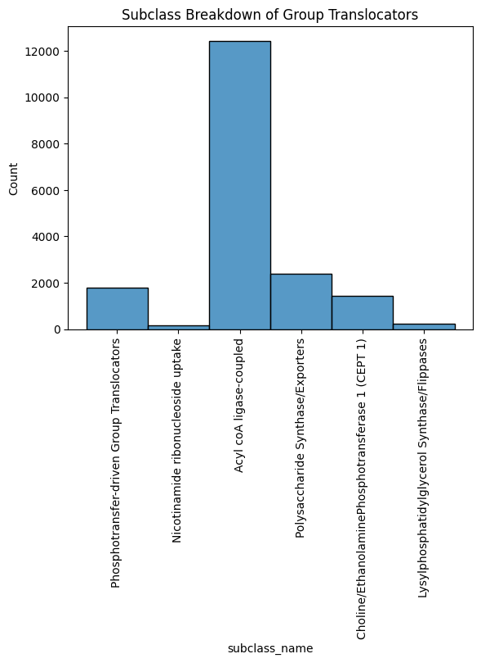
Subclass break down cont.

Slide 12
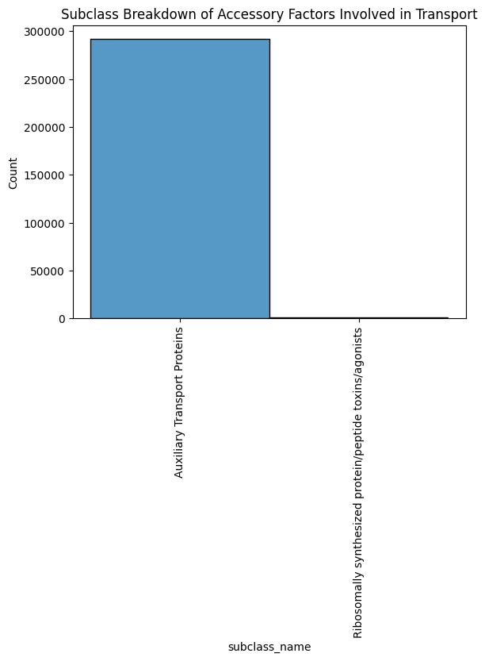
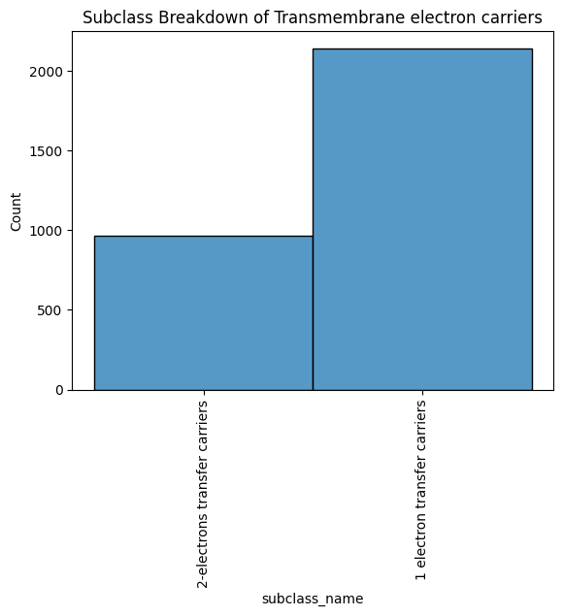
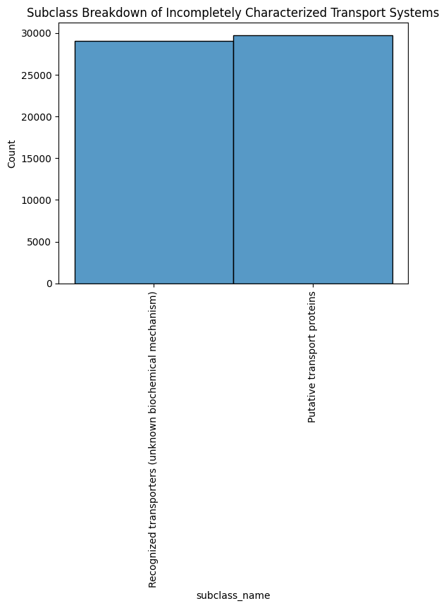
Subclass break down cont.

Slide 13
Next steps- all in tandem
Data exploration
Refence DB
Cross Refencing
Run Npac proteins against refence
Generate abundance plots
Dive into other data collected to generate plots that explore deeper questions
Comb through InterPro and member DBs to collect more transporter HMMs
Find a way to standardize results
Verify that abundances make sense contextually

Slide 14
THANK YOU

